Slide 1
OBI – a high level overview
Bjoern Peters
3/21/2011
San Diego Workshop

Slide 2
OBI – a user driven project
19 communities that recognized they were trying to solve the same / related problems
6 year effort
1-2 phone calls per week, 1-2 meetings per year
first stable release (Philly / 1.0) in Oct. 2009
Paper submitted to Nat. Biotechnology (positive reviews but major revisions…)
→ [Chris]

Slide 3
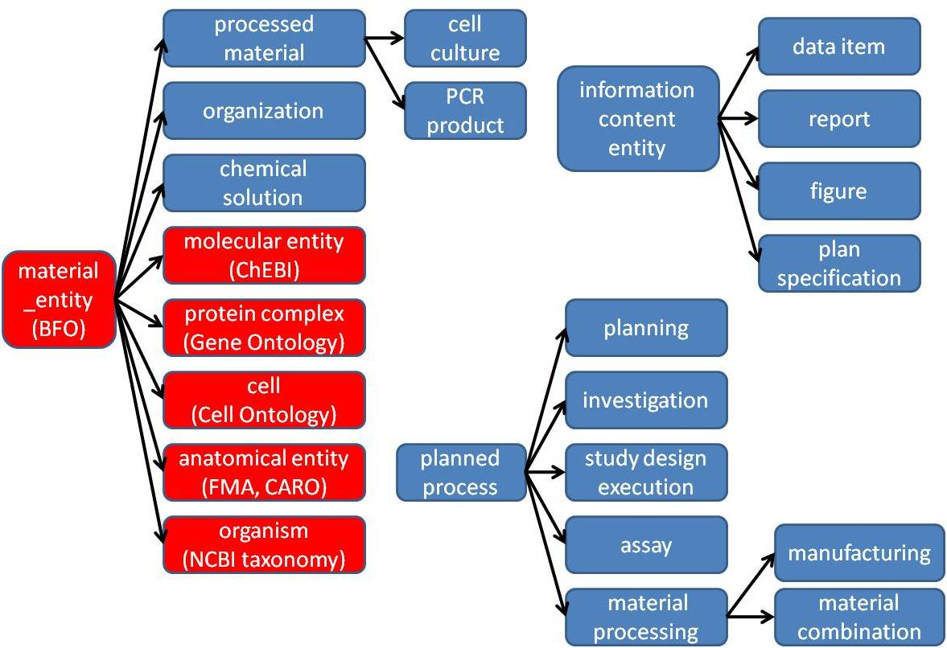
High level class hierarchy

Slide 4
material entity
merged bfo:object, object part, object aggregate (what is a cell inside my body?)
import ‘natural biomaterials’ (MIREOT mechanism), e.g. organism (NCBI taxonomy), anatomical entity (FMA), molecular entity (ChEBI)
OBI’s primary scope
‘processed material entities’
output of a planned material transformation process
would not exist without intelligent life around
some ‘natural biomaterials’ can also be created (e.g. molecules) → no asserted disjoint
specimen, study subject
material entities about which information is gathered during an investigation
may or may not be processed materials

Slide 5
planned process
realize a ‘plan specification’ which includes an ‘objective specification’ (describing the desired endpoint)
have specified inputs and outputs (=participants called out in the specification)
high level classes:
material processing
assay
data transformation

Slide 6
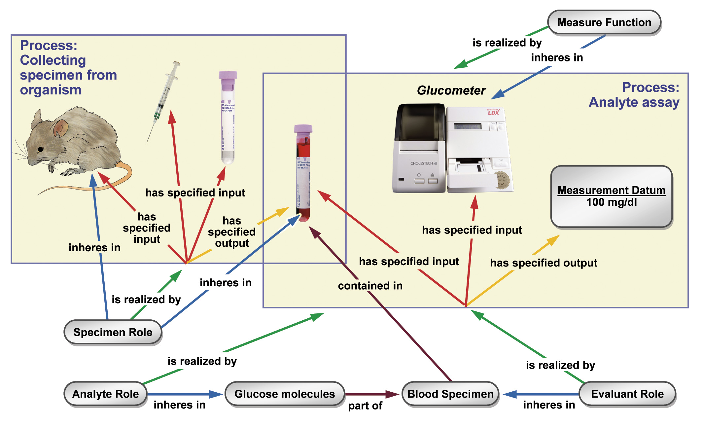

Slide 7
information content entities
IAO, separate effort spawned of from OBI, but tightly interlinked
every information content entity is_about something
Examples: plan specification, journal article, data item
OBI subclasses these, e.g.: study design, dependent variable specification, measurement datum

Slide 8
More classes
roles – specimen role, author role
functions – contain function, measurement function
organizations – manufacturer, regulatory agency

Slide 9
Conclusions
core structure is in place, solidified over several years, and now usable
design process has been formalized, novel elements have been developed
… but there is more than enough to do.

Slide 10
Immune Epitope Database

Slide 11
Goals of the Immune Epitope Database and Analysis Resource (IEDB)‏
To catalog, organize and make accessible immune epitope related information
B and T cell epitopes, MHC binding, MHC ligand elution
Scope: infectious diseases, allergy, autoimmunity , transplantation. (No HIV or cancer)
Develop new methods to predict and model immune responses (→ IEDB Analysis Resource)

Slide 12

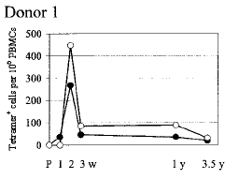
Consistent data entry from multiple sources requires well defined data structure
Epitope discovery contract submission
Literature curation
IEDB www.iedb.org

Slide 13
High level database structure
epitope source (material entity)
organism
protein
protein complex
has part
peptide
journal article
epitope structure
(material entity)
discontinuous protein residues
reference (document)
is about
author submission
carbohydrate
has participant
immune recognition assay (process)
B cell response
immunization (process)
Natural Infection
preceded by
T cell response
Administered Immunization
MHC binding

Slide 14
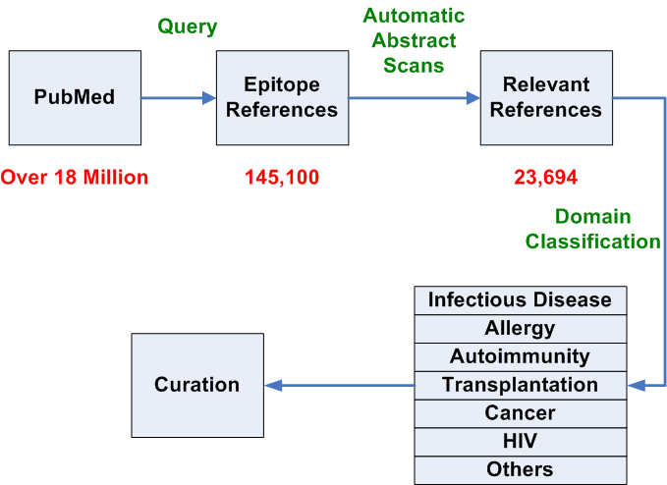
Process for categorization and curation of epitope references
Notes:
Ward; let’s discuss on how to make this stepwise

Slide 15
Literature Curation Status
Main Classes | Journal articles
 | Total Relevant | Outstanding | % Processed
Infectious Disease | 8,651 | 395 | 98.9
Allergy | 768 | 38 | 98.3
Autoimmunity | 3,889 | 2,858 | 47.5
Transplant | 605 | 582 | 3.8
Total | 13,913 | 3,873 | 80.4
Notes:
Update; show non peptidic

Slide 16
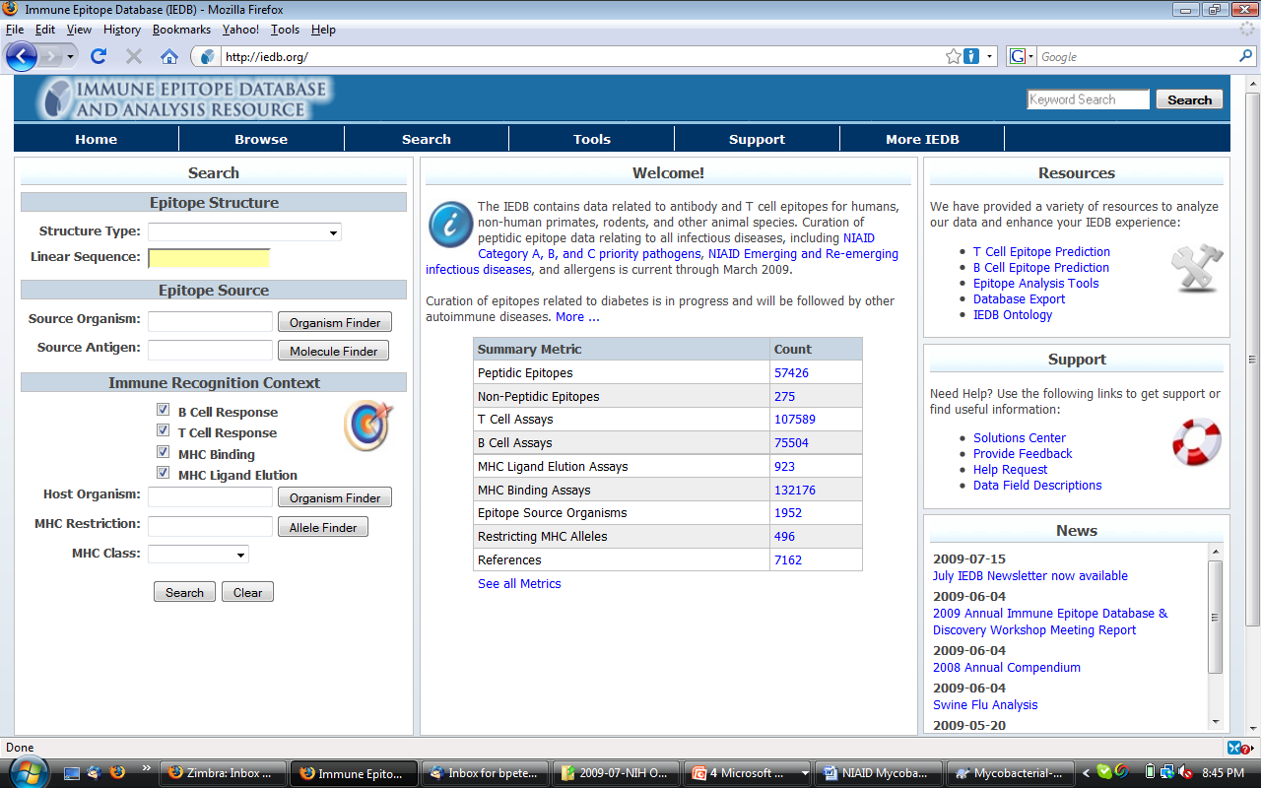

Slide 17
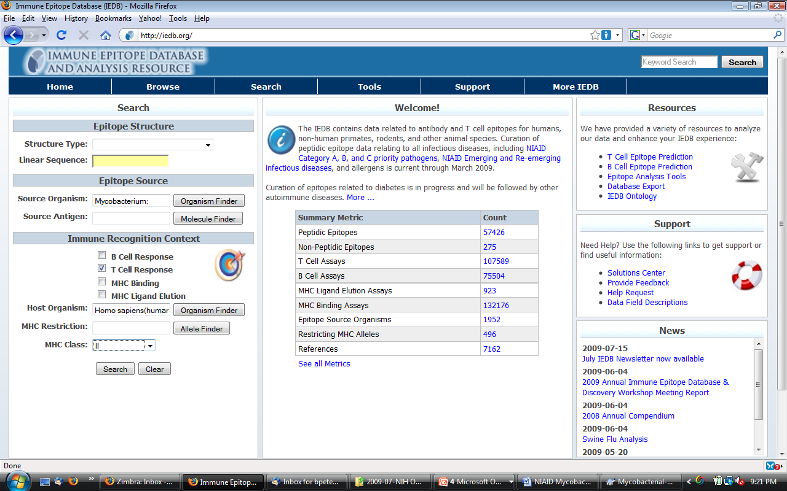

Slide 18
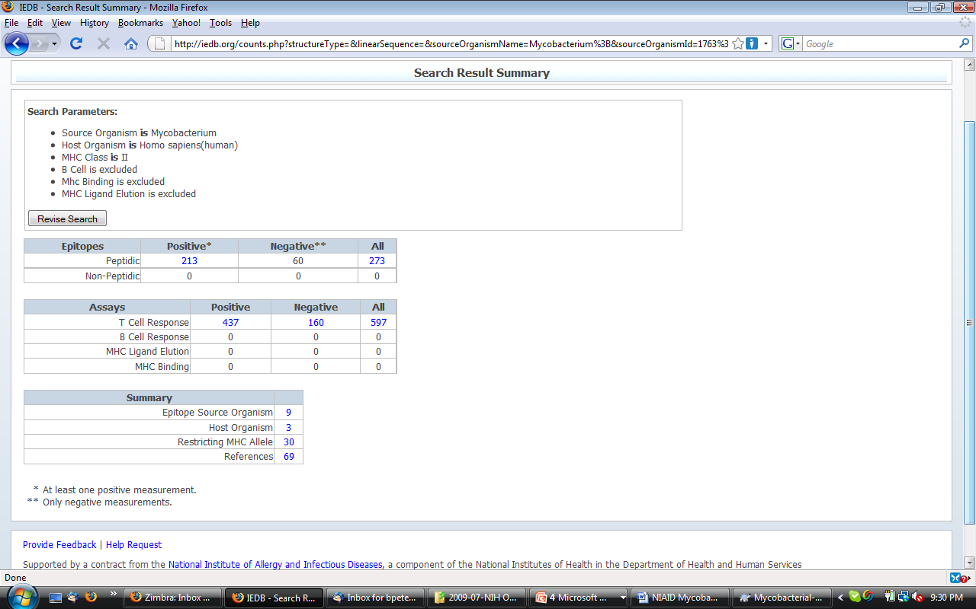

Slide 19
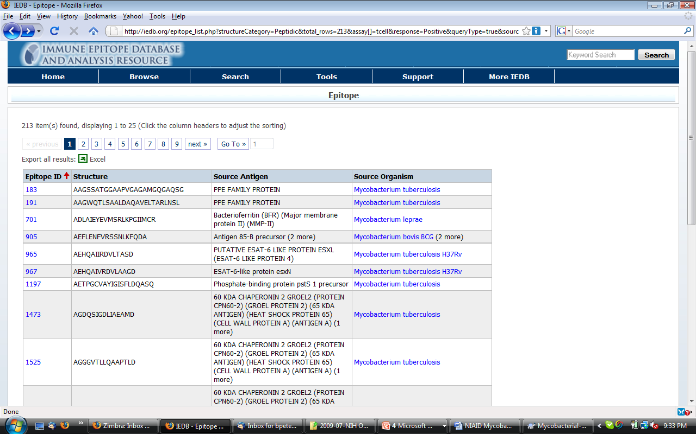

Slide 20
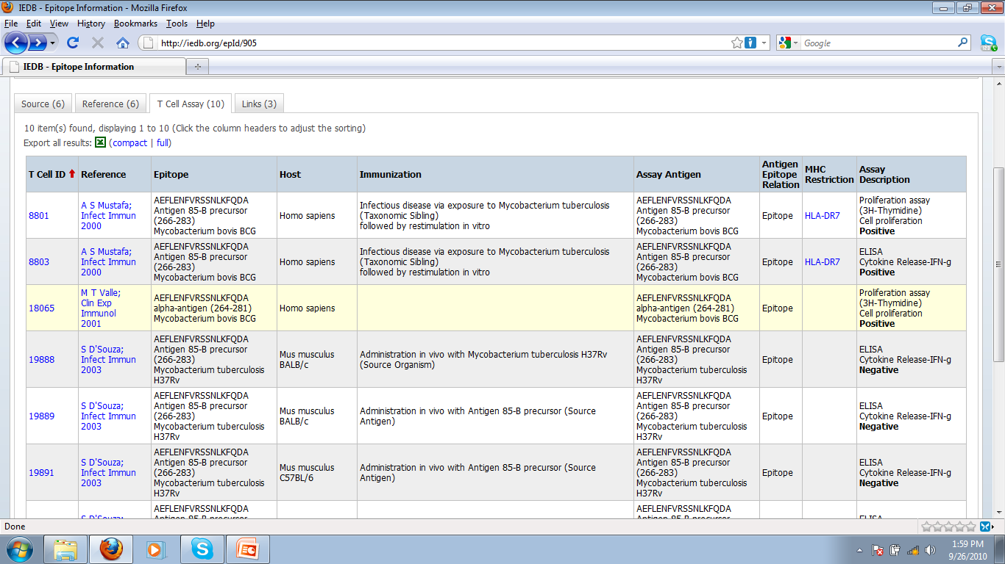

Slide 21
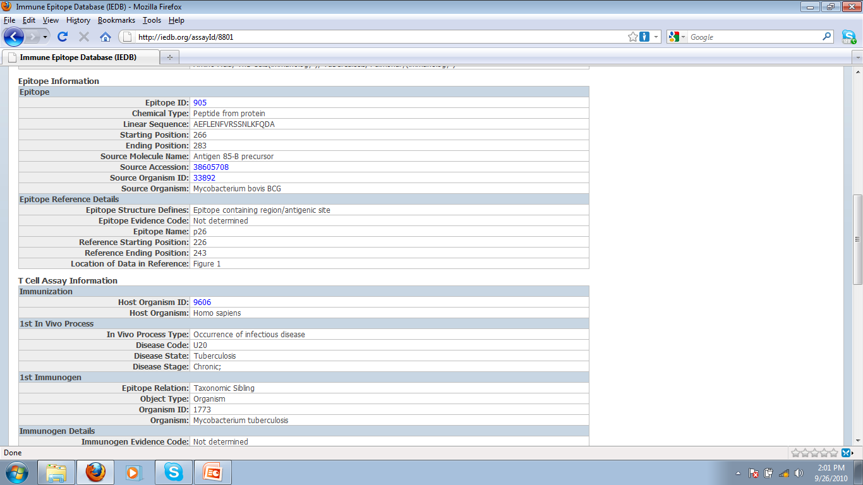

Slide 22
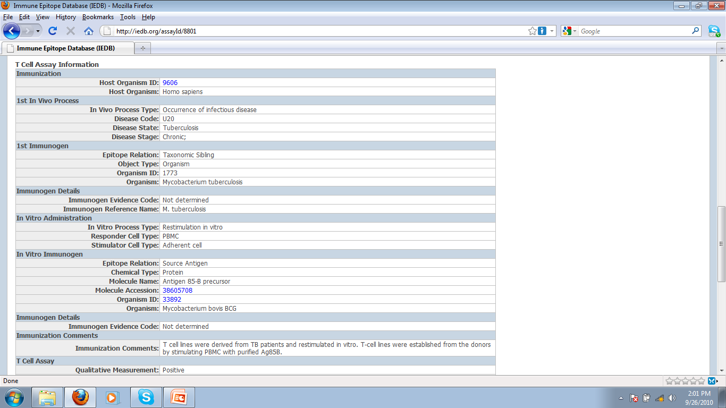

Slide 23
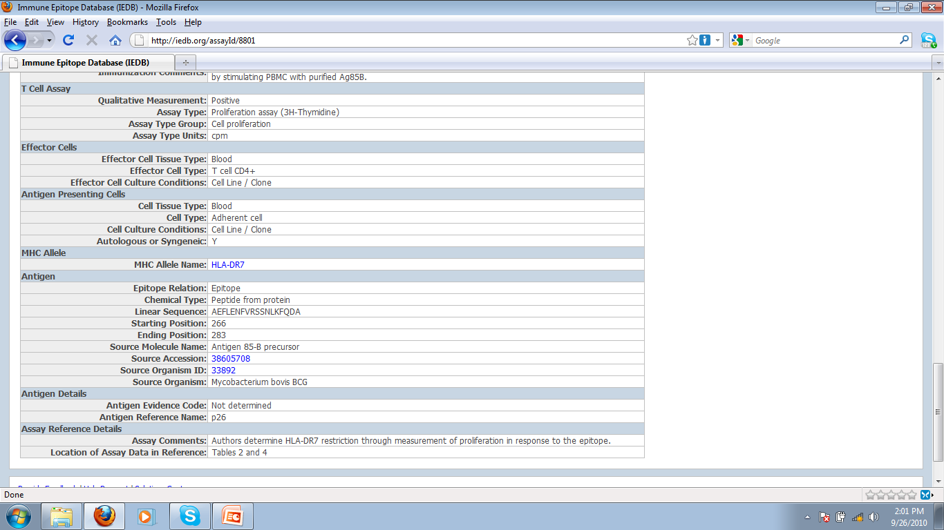

Slide 24
OBI development for IEDB
Provide mapping of all content in the IEDB to OBI (in OWL)
Primary current focus: assays (Tuesday session)
→ Needs to be capable to present all T cell epitope experiments ever made (100k+)

